Slide 1

Network Reference Models
2.<number>
Copyright © The McGraw-Hill Companies, Inc. Permission required for reproduction or display.

Slide 2
2-1 LAYERED TASKS
We use the concept of layers in our daily life. As an example, let us consider two friends who communicate through postal mail. The process of sending a letter to a friend would be complex if there were no services available from the post office.
Topics discussed in this section:
Sender, Receiver, and Carrier
Hierarchy
2.<number>

Slide 3

Figure 2.1 Tasks involved in sending a letter
2.<number>

Slide 4
The Postal Analogy: How would the OSI compare to the regular Post Office
Application
A- Write a 20 page letter to a foreign country.
P- Translate the letter so the receiver can read it.
S- Insure the intended recipient can receive letter.
T- Separate and number pages. Like registered mail, tracks delivery and requests another package if one is “lost” or “damaged” in the mail.
N- Postal Center sorting letters by zip code to route them closer to destination.
D- Local Post Office determining which vehicles to deliver letters.
P- Physical Trucks, Planes, Rail, autos, etc which carry letter between stations.
Presentation
Session
Transport
Network
Data-Link
Physical
2.<number>

Slide 5
2-2 THE OSI MODEL
Established in 1947, the International Standards Organization (ISO) is a multinational body dedicated to worldwide agreement on international standards. An ISO standard that covers all aspects of network communications is the Open Systems Interconnection (OSI) model. It was first introduced in the late 1970s.
Topics discussed in this section:
Layered Architecture
Peer-to-Peer Processes
Encapsulation
2.<number>

Slide 6

Note
ISO is the organization.
OSI is the model.
2.<number>

Slide 7

Figure 2.2 Seven layers of the OSI model
2.<number>

Slide 8
Figure Seven layers of the OSI model with their roles and description
OSI Model
 | Data unit | Layer | Function
Host layers | Data | 7. Application | Network process to application
 |  | 6. Presentation | Data representation, encryption and decryption
 |  | 5. Session | Interhost communication
 | Segments | 4. Transport | End-to-end connections and reliability, Flow control
Media layers | Packet | 3. Network | Path determination and logical addressing
 | Frame | 2. Data Link | Physical addressing
 | Bit | 1. Physical | Media, signal and binary transmission
Going from layer 1 to 7: Please Do Not Throw Sausage Pizza Away
Going from layer 7 to 1: All People Seem To Need Data Processing
2.<number>

Slide 9

Figure 2.3 The interaction between layers in the OSI model
2.<number>

Slide 10

Figure 2.4 An exchange using the OSI model
2.<number>

Slide 11
2-3 LAYERS IN THE OSI MODEL
In this section we briefly describe the functions of each layer in the OSI model.
Topics discussed in this section:
Physical Layer
Data Link Layer
Network Layer
Transport Layer
Session Layer
Presentation Layer
Application Layer
2.<number>

Slide 12

Figure 2.5 Physical layer
2.<number>

Slide 13
Note
The physical layer is responsible for movements of
individual bits from one hop (node) to the next.
2.<number>

Slide 14

Figure 2.6 Data link layer
2.<number>

Slide 15
Note
The data link layer is responsible for moving
frames from one hop (node) to the next.
2.<number>

Slide 16

Figure 2.7 Hop-to-hop delivery
2.<number>

Slide 17

Figure 2.8 Network layer
2.<number>

Slide 18
Note
The network layer is responsible for the
delivery of individual packets from
the source host to the destination host.
2.<number>

Slide 19

Figure 2.9 Source-to-destination delivery
2.<number>

Slide 20

Figure 2.10 Transport layer
2.<number>

Slide 21
Note
The transport layer is responsible for the delivery
of a message from one process to another.
2.<number>

Slide 22

Figure 2.11 Reliable process-to-process delivery of a message
2.<number>

Slide 23

Figure 2.12 Session layer
2.<number>

Slide 24
Note
The session layer is responsible for dialog
control and synchronization.
2.<number>

Slide 25

Figure 2.13 Presentation layer
2.<number>

Slide 26
Note
The presentation layer is responsible for translation, compression, and encryption.
2.<number>

Slide 27

Figure 2.14 Application layer
2.<number>

Slide 28
Note
The application layer is responsible for
providing services to the user.
2.<number>

Slide 29

Figure 2.15 Summary of layers
2.<number>

Slide 30
2-4 TCP/IP PROTOCOL SUITE
The layers in the TCP/IP protocol suite do not exactly match those in the OSI model. The original TCP/IP protocol suite was defined as having four layers: host-to-network, internet, transport, and application. However, when TCP/IP is compared to OSI, we can say that the TCP/IP protocol suite is made of five layers: physical, data link, network, transport, and application.
Topics discussed in this section:
Physical and Data Link Layers
Network Layer
Transport Layer
Application Layer
2.<number>

Slide 31

Figure 2.16 TCP/IP and OSI model
2.<number>

Slide 32
2-5 ADDRESSING
Four levels of addresses are used in an internet employing the TCP/IP protocols: physical, logical, port, and specific.
Topics discussed in this section:
Physical Addresses
Logical Addresses
Port Addresses
Specific Addresses
2.<number>

Slide 33

Figure 2.17 Addresses in TCP/IP
2.<number>

Slide 34

Figure 2.18 Relationship of layers and addresses in TCP/IP
2.<number>

Slide 35
Example 2.1
In Figure 2.19 a node with physical address 10 sends a frame to a node with physical address 87. The two nodes are connected by a link (bus topology LAN). As the figure shows, the computer with physical address 10 is the sender, and the computer with physical address 87 is the receiver.
2.<number>

Slide 36

Figure 2.19 Physical addresses
2.<number>

Slide 37
Example 2.2
Most local-area networks use a 48-bit (6-byte) physical address written as 12 hexadecimal digits; every byte (2 hexadecimal digits) is separated by a colon, as shown below:
07:01:02:01:2C:4B
A 6-byte (12 hexadecimal digits) physical address.
2.<number>

Slide 38
Example 2.3
Figure 2.20 shows a part of an internet with two routers connecting three LANs. Each device (computer or router) has a pair of addresses (logical and physical) for each connection. In this case, each computer is connected to only one link and therefore has only one pair of addresses. Each router, however, is connected to three networks (only two are shown in the figure). So each router has three pairs of addresses, one for each connection.
2.<number>

Slide 39

Figure 2.20 IP addresses
2.<number>

Slide 40
Example 2.4
Figure 2.21 shows two computers communicating via the Internet. The sending computer is running three processes at this time with port addresses a, b, and c. The receiving computer is running two processes at this time with port addresses j and k. Process a in the sending computer needs to communicate with process j in the receiving computer. Note that although physical addresses change from hop to hop, logical and port addresses remain the same from the source to destination.
2.<number>

Slide 41

Figure 2.21 Port addresses
2.<number>

Slide 42
Note
The physical addresses will change from hop to hop,
but the logical addresses usually remain the same.
2.<number>

Slide 43
Example 2.5
A port address is a 16-bit address represented by one decimal number as shown.
753
A 16-bit port address represented
as one single number.
2.<number>

Slide 44
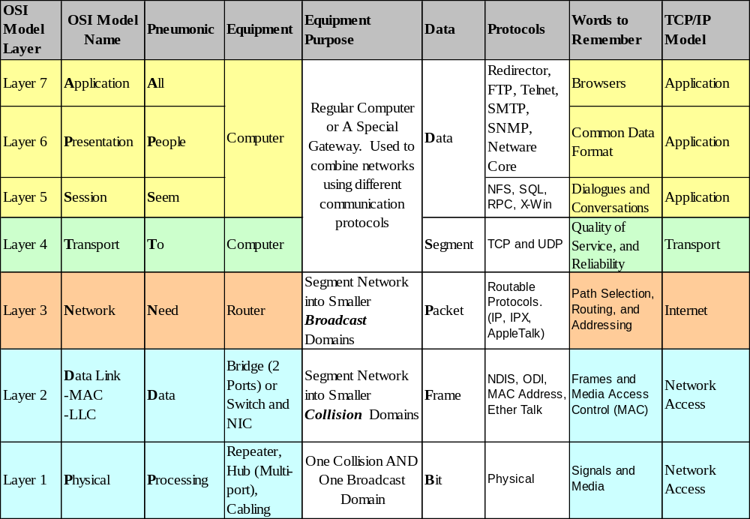
How the OSI and TCP/IP Models Relate in a Networking Environment
2.<number>

